Slide 1

INTRODUCTION TO HADOOP

Slide 2
Outline/next
Schedule
What is Big Data?
The Hadoop distributed computing architecture MapReduce
HDFS hands-on exercises MapReduce hands-on
The YARN resource manager MRjob
Benchmarking I/O with testDFSio Concluding remarks

Slide 3
What is Big Data?

Slide 4

What is Big Data?
"Big Data" is the catch-all term for massive amounts of data as well as for frameworks and R&D initiatives aimed at working with them efficiently.
4/101

Slide 5
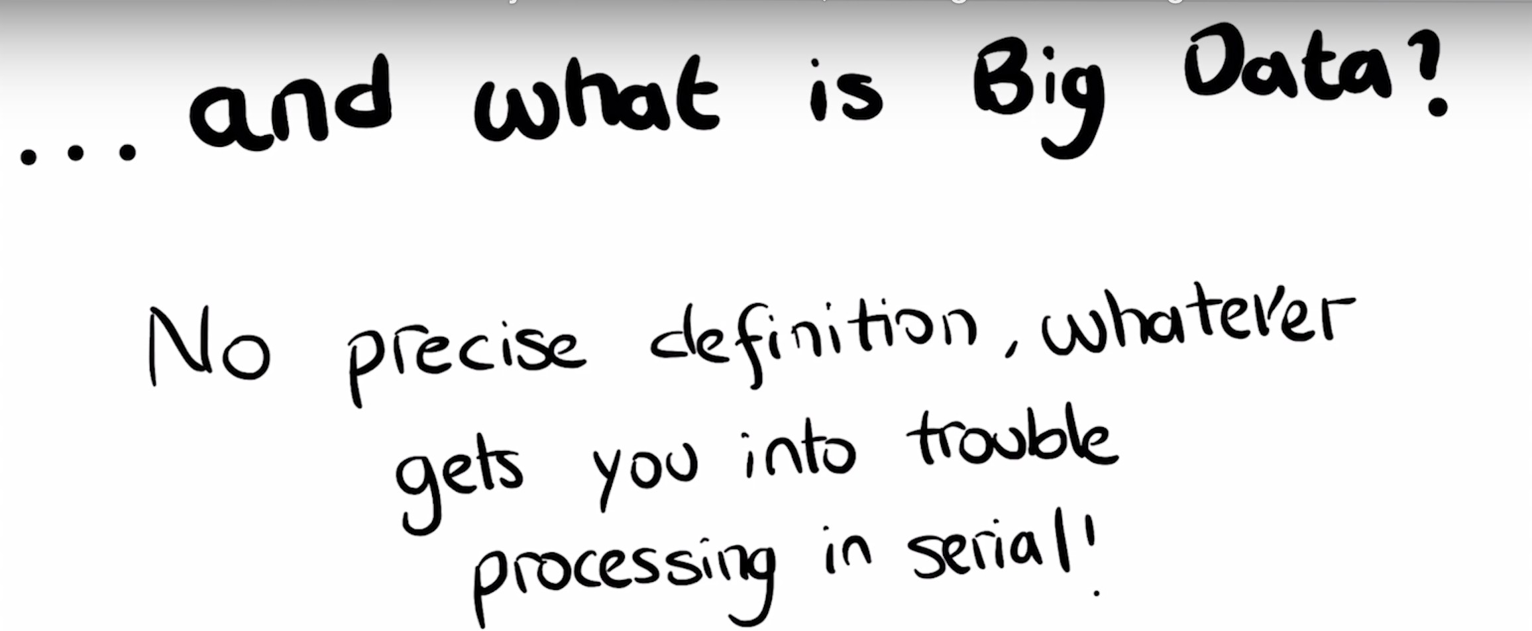
A short definition of Big Data
5/101

Slide 6
The three V’s of Big Data
It is customary to define Big Data in terms of three V’s:
Volume (the sheer volume of data)
Velocity (rate of flow of the data and processing speed needs) Variety (different sources and formats)
6/101

Slide 7

The three V’s of Big Data
Data arise from disparate sources and come in many sizes and formats. Velocity refers to the speed of data generation as well as to processing speed requirements.
Volume | Velocity | Variety
MB | batch | table
GB | periodic | database
TB | near-real time | multimedia
PB | real time | unstructured
... | ... | ...
7/101

Slide 8
Reference: metric prefixes
1000000000000000000000000 | ₁₀24 | yotta | Y | septillion
1000000000000000000000 | ₁₀21 | zetta | Z | sextillion
1000000000000000000 | ₁₀18 | exa | E | quintillion
1000000000000000 | ₁₀15 | peta | P | quadrillion
1000000000000 | ₁₀12 | tera | T | trillion
1000000000 | 10⁹ | giga | G | billion
1000000 | 10⁶ | mega | M | million
1000 | 10³ | kilo | k | thousand
Note: 1 Gigabyte (GB) is 10⁹ bytes. Sometimes GB is also used to denote 1024³ or 2³0 bytes, which is actually one gibibyte (GiB).

Slide 9
Structured vs. unstructured data
By structured data one refers to highly organized data that are usually stored in relational databases or data warehouses. Structured data are easy to search but unflexible in terms of the three "V"s.
Unstructured data come in mixed formats, usually require pre-processing, and are difficult to search. Structured data are usually stored in noSQL databases or in data lakes (these are scalable storage spaces for raw data of mixed formats).

Slide 10

Examples of structured/unstructured data
Industry Structured data Unstructured data
products & prices customer data transactions
reviews
phone transcripts social media mentions
e-commerce
customer communication regulations & compliance financial news
financial transactions customer data
banking
patient data medical billing data
clinical reports radiology imagery
healthcare

Slide 11
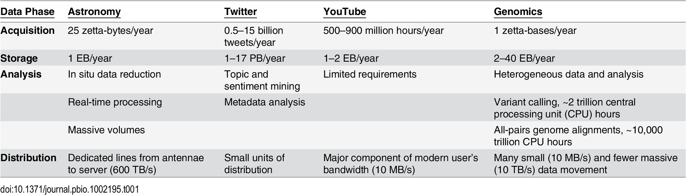
Big Data in 2025
This table¹ shows the projected annual storage and computing needs in four domains (astronomy, social media, genomics)
¹Stephens ZD et al. “Big Data: Astronomical or Genomical?” In: PLoS Biol (2015).

Slide 12
The three V’s of Big Data: additional dimensions
Three more "V"s to be pondered:
Veracity (quality or trustworthiness of data) Value (economic value of the data)
Variability (general variability in any of the aforementioned characteristics)

Slide 13
The challenges of Big Data
Anyone working with large amounts of data will sooner or later be confronted with one or more of these challenges:
disk and memory space processing speed hardware faults
network capacity and speed need to optimize resources use

Slide 14

Distributed computing for Big Data
Traditional technologies are inadequate for processing large amounts of data efficiently.
Distributed computation makes it possible to work with Big Data using reasonable amounts of time and resources.

Slide 15
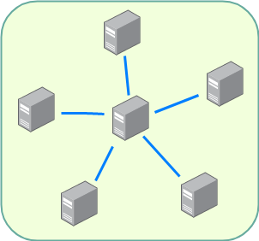
What is distributed computing?
A distributed computer system consists of several interconnected nodes. Nodes can be physical as well as virtual machines or containers.
When a group of nodes provides services and applications to the client as if it were a single machine, then it is also called a cluster.

Slide 16
Main benefits of distributed computing
Performance: supports intensive workloads by spreading tasks across nodes
Scalability: new nodes can be added to increase capacity
Fault tolerance: resilience in case of hardware failures

Slide 17
The Hadoop distributed computing architecture

Slide 18
Hadoop for distributed data processing
Hadoop is a framework for running jobs on clusters of computers that provides a good abstraction of the underlying hardware and software.
“Stripped to its core, the tools that Hadoop provides for building distributed systems—for data storage, data analysis, and coordination—are simple. If there’s a common theme, it is about raising the level of abstraction—to create building blocks for programmers who just happen to have lots of data to store, or lots of data to analyze, or lots of machines to coordinate, and who don’t have the time, the skill, or the inclination to become distributed systems experts to build the infrastructure to handle it.²”
²White T. Hadoop: The Definitive Guide. O’Reilly, 1988.

Slide 19
Hadoop: some facts
Hadoop³ is an open-source project of the Apache Software Foundation. The project was created to facilitate computations involving massive amounts of data.
its core components are implemented in Java
initially released in 2006. Last stable version is 3.3.5 from June 2023
originally inspired by Google‘s MapReduce⁴ and the proprietary GFS (Google File System)
³Apache Software Foundation. Hadoop. url: https://hadoop.apache.org.
⁴J. Dean and S. Ghemawat. “MapReduce: Simplified data processing on large clusters.” In: Proceedings of Operating Systems Design and Implementation (OSDI). 2004. url: https://www.usenix.org/legacy/publications/library/proceedings/ osdi04/tech/full_papers/dean/dean.pdf.

Slide 20
Hadoop’s features
Hadoop’s features addressing the challenges of Big Data:
scalability
fault tolerance
high availability
distributed cache/data locality
cost-effectiveness as it does not need high-end hardware
provides a good abstraction of the underlying hardware
easy to learn
data can be queried trough SQL-like endpoints (Hive, Cassandra)

Slide 21
Mini-glossary of Hadoop’s distinguishing features
fault tolerance: the ability to withstand hardware or network failures (also: resilience)
high availability : this refers to the system minimizing downtimes by eliminating single points of failure
data locality : task are run on the node where data are located, in order to reduce the cost of moving data around

Slide 22
The Hadoop core
The core of Hadoop consists of:
Hadoop common, the core libraries
HDFS, the Hadoop Distributed File System MapReduce
the YARN (Yet Another Resource Negotiator) resource manager

Slide 23
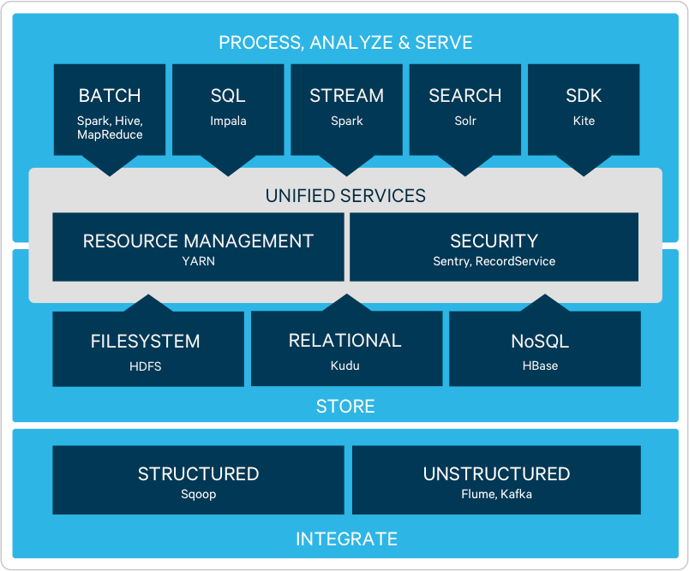
The Hadoop ecosystem
There’s a whole constellation of open source components for collecting, storing, and processing big data that integrate with Hadoop.

Slide 24
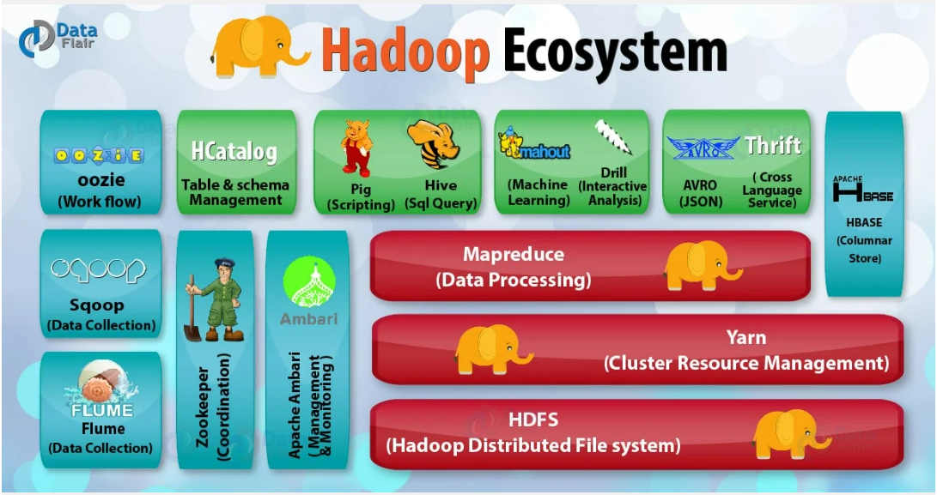
The Hadoop ecosystem

Slide 25
The Hadoop Distributed File System (HDFS)
HDFS stands for Hadoop Distributed File System and it takes care of partitioning data across a cluster.
In order to prevent data loss and/or task termination due to hardware failures HDFS uses either
replication (creating multiple copies —usually 3— of the data) erasure coding
Data redundancy (obtained through replication or erasure coding) is the basis of Hadoop’s fault tolerance.

Slide 26
Replication vs. Erasure Coding
In order to provide protection against failures one introduces:
data redundancy
a method to recover the lost data using the redundant data
Replication is the simplest method for coding data by making n copies of the data. n-fold replication guarantees the availability of data for at most
n − 1 failures and it has a storage overhead of 200% (this is equivalent to a
storage efficiency of 33%).
Erasure coding provides a better storage efficiency (up to to 71%) but it can be more costly than replication in terms of performance.

Slide 27
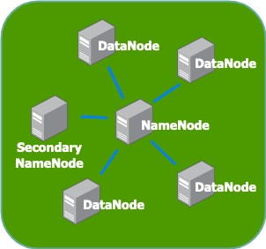
HDFS architecture
A typical Hadoop cluster installation consists of:
a NameNode
a secondary NameNode multiple DataNodes

Slide 28
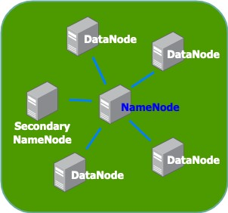
HDFS architecture: NameNode
NameNode
The NameNode is the main point of access of a Hadoop cluster. It is responsible for the bookkeeping of the data partitioned across the DataNodes, manages the whole filesystem metadata, and performs load balancing

Slide 29
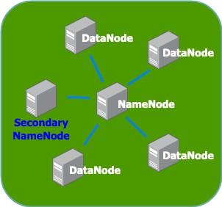
HDFS architecture: Secondary NameNode
Secondary NameNode
Keeps track of changes in the NameNode performing regular snapshots, thus allowing quick startup.
An additional standby node is needed to guarantee high availability (since the NameNode is a single point of failure).

Slide 30
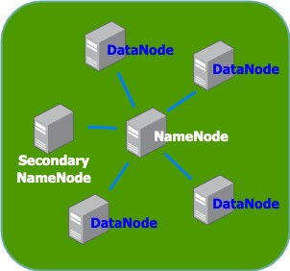
HDFS architecture: DataNode
DataNode
Here is where the data is saved and the computations take place (data nodes should actually be called "data and worker nodes")

Slide 31
HDFS architecture: internal data representation
HDFS supports working with very large files.
Internally, data are split into blocks. One of the reason for splitting data into blocks is that in this way block objects all have the same size.
The block size in HDFS can be configured at installation time and it is by default 128MB
Note: Hadoop sees data as a bunch of records and it processes multiple files the same way it does with a single file. So, if the input is a directory instead of a single file, it will process all files in that directory.

Slide 32
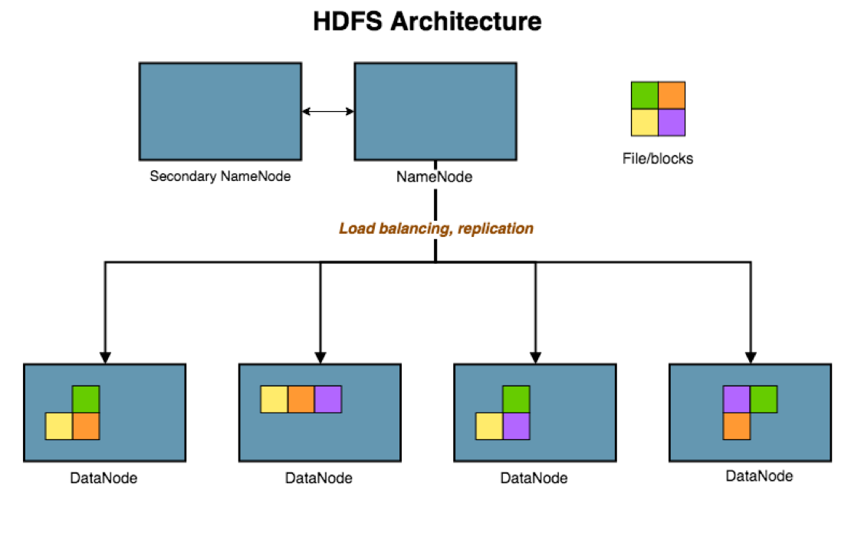
HDFS architecture

Slide 33
DataNode failures
Each DataNode sends a Heartbeat message to the NameNode periodically. Whenever a DataNode becomes unavailable (due to network or hardware failure), the NameNode stops sending requests to that node and creates new replicas of the blocks stored on that node.

Slide 34
The WORM principle of HDFS
The Hadoop Distributed File System relies on a simple design principle for data known as Write Once Read Many (WORM).
“A file once created, written, and closed need not be changed except for appends and truncates. Appending the content to the end of the files is supported but cannot be updated at arbitrary point. This assumption simplifies data coherency issues and enables high throughput data access.⁵”
The data immutability paradigm is also discussed in Chapter 2 of "Big Data".⁶
⁵Apache Software Foundation. Hadoop. url: https://hadoop.apache.org/docs/stable/hadoop-project-dist/hadoop- hdfs/HdfsDesign.html.
⁶Warren J. and Marz N. Big Data. Manning publications, 1988.

Slide 35
MapReduce

Slide 36
The origins of MapReduce
MapReduce MapReduce
The 2004 paper “MapReduce: Simplified Data Processing on Large Clusters” by two members of Google’s R&D team, Jeffrey Dean and Sanjay Ghemawat, is the seminal article on MapReduce.
The article describes the methods used to split, process, and aggregate the large amount of data for the Google search engine.
The open-source version of MapReduce was later released within the Apache Hadoop project.

Slide 37
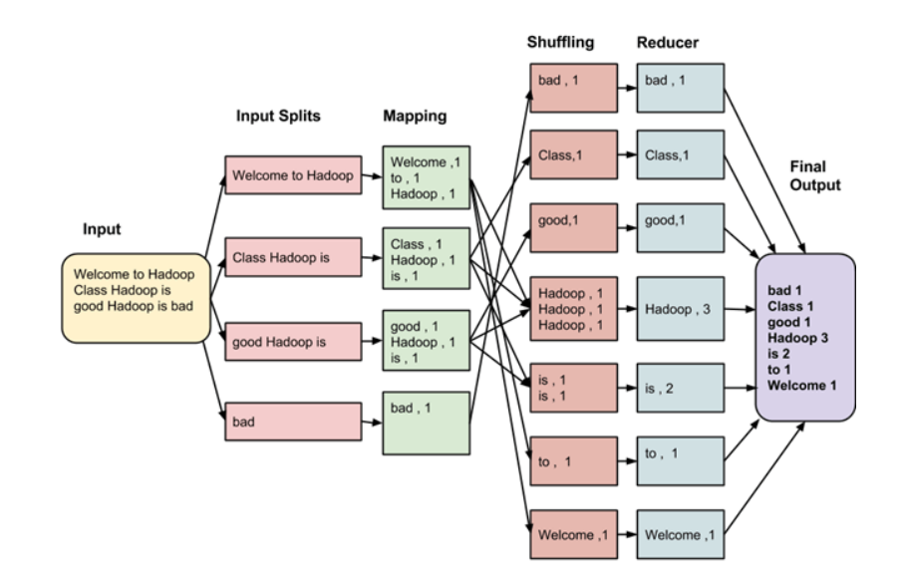
MapReduce explained

Slide 38
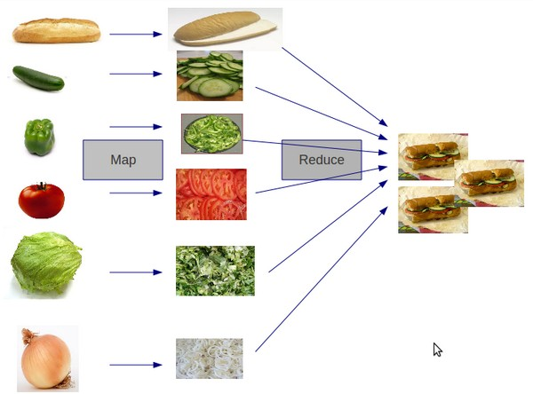
MapReduce explained
Image source: Stack Overflow

Slide 39
MapReduce explained
The MapReduce paradigm is inspired by the computing model commonly used in functional programming.
Applying the same function independently to items in a dataset either to transform (map) or collate (reduce) them into new values, works well in a distributed environment.

Slide 40
The phases of MapReduce
The phases of a MapReduce job:
split: data is partitioned across several computer nodes
map: apply a map function to each chunk of data
sort & shuffle: the output of the mappers is sorted and distributed to the reducers
reduce: finally, a reduce function is applied to the data and an output is produced

Slide 41
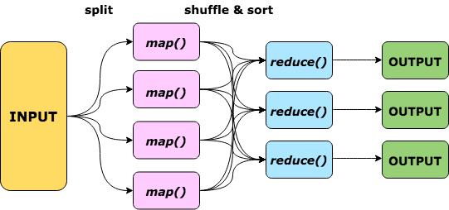
The phases of MapReduce

Slide 42
The phases of MapReduce
We have seen that a MapReduce job consists of four phases:
split map
sort & shuffle reduce
While splitting, sorting and shuffling are done by the framework, the map and reduce functions are defined by the user.
It is also possible for the user to interact with the splitting, sorting and shuffling phases and change their default behavior, for instance by managing the amount of splitting or defining the sorting comparator. This will be illustrated in the hands-on exercises.

Slide 43
MapReduce: some notes
Notes
the same map (and reduce) function is applied to all the chunks in the data
the map and reduce computations can be carried out in parallel because they’re completely independent from one another.
the split is not the same as the internal partitioning into blocks

Slide 44
MapReduce: shuffling and sorting
The shuffling and sorting phase is often the the most costly in a MapReduce job.
The mapper takes as input unsorted data and emits key-value pairs. The purpose of sorting is to provide data that is already grouped by key to the reducer. This way reducers can start working as soon as a group (identified by a key) is filled.

Slide 45
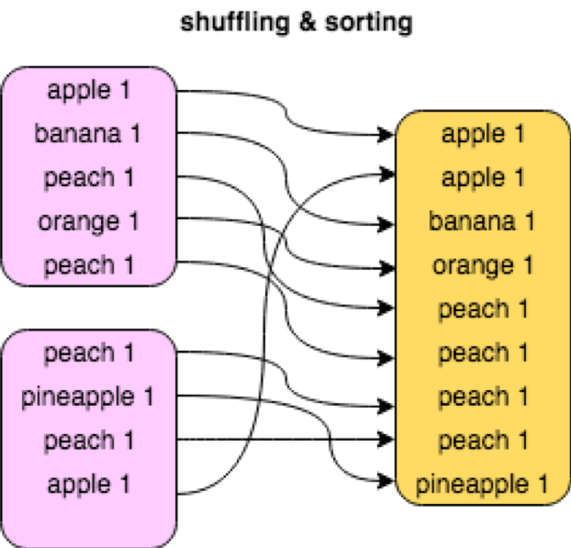
MapReduce: shuffling and sorting

Slide 46
The YARN resource manager

Slide 47
YARN: Yet Another Resource Negotiator
Hadoop jobs are usually managed by YARN (acronym for Yet Another Resource Negotiator), that is responsible for allocating resources and managing job scheduling. Basic resource types are:
memory (memory-mb) virtual cores (vcores)
YARN supports an extensible resource model that allows to define any countable resource. A countable resource is a resource that is consumed while a container is running, but is released afterwards. Such a resource can be for instance:
GPU (gpu)

Slide 48
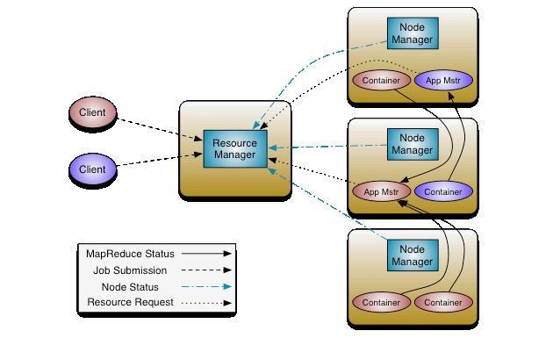
YARN architecture
Image source: Apache Software Foundation

Slide 49
YARN architecture
Each job submitted to the Yarn is assigned:
a container : this is an abstract entity which incorporates resources such as memory, cpu, disk, network etc. Container resources are allocated by YARN’s Scheduler.
an ApplicationMaster service assigned by the Application Manager for monitoring the progress of the job, restarting tasks if needed

Slide 50
YARN architecture
The main idea of Yarn is to have two distinct daemons for job monitoring and scheduling, one global and one local for each application:
the Resource Manager is the global job manager, consisting of:
Scheduler: allocates resources across all applications Applications Manager: accepts job submissions, restart Application Masters on failure
an Application Master is the local application manager, responsible for negotiating resources, monitoring status of the job, restarting failed tasks

Slide 51
Dynamic resource pools
Sharing computing resources fairly can be a big issue in multi-user environments.
YARN supports dynamic resource pools for scheduling applications.
A resource pool is a given configuration of resources to which a group of users is granted access. Whenever a group is not active, the resources are preempted and granted to other groups.
Groups are assigned a priority and resources are shared among groups according to these priority values.
Additionally, resource configurations can be scheduled for specific intervals of time.

Slide 52
YARN on SLURM
When running YARN on top of SLURM, it is not clear how to take advantage of the flexibility of YARN’s dynamic resource pools to optimize resource utilization.
How to leverage the bses characteristics of job schedulers from both Big Data and HPC architectures in order to decrease latency is a subject of active study.

Slide 53
HDFS hands-on exercises

Slide 54
Where to find commands listing
For this part of the training you will need to activate the Hadoop module using the command:
module load Hadoop/2.6.0-cdh5.8.0-native
All commands in this section can be found in the file:
HDFS_commands.txt

Slide 55
Basic HDFS filesystem commands
One can regard HDFS as a regular file system, in fact many HDFS shell commands are inherited from the corresponding bash commands.
To run a command on an Hadoop filesystem use the prefix hdfs dfs, for instance use:
hdfs dfs - mkdir myDir
to create a new directory myDir on HDFS.
Note: One can use interchangeably hadoop or hdfs dfs when working on a HDFS file system. The command hadoop is more generic because it can be used not only on HDFS but also on other file systems that Hadoop supports (such as Local FS, WebHDFS, S3 FS, and others).

Slide 56
Basic HDFS filesystem commands
Basic HDFS filesystem commands that also exist in bash
hdfs dfs -mkdir | create a directory
hdfs dfs -ls | list files
hdfs dfs -cp | copy files
hdfs dfs -cat | print files
hdfs dfs -tail | output last part of a file
hdfs dfs -rm | remove files

Slide 57
Basic HDFS filesystem commands
Here’s three basic commands that are specific to HDFS.
hdfs dfs –put | Copy single src, or multiple srcs from local file system to the destination file system
hdfs dfs –get | Copy files to the local file sys- tem
hdfs dfs -usage | get help on hadoop fs

Slide 58
Basic HDFS filesystem commands
To get more help on a specific hdfs command use: hdfs -help
<command>
$ hdfs dfs - help tail
# - tail [- f] <file > :
# Show the last 1 KB of the file .
# -f Shows appended data as the file grows .

Slide 59
Some things to try
# create a new directory called " input " on HDFS hdfs dfs - mkdir input
# copy local file wiki_ 1 k_lines to input on hdfs dfs - put wiki_ 1 k_lines input /
# list contents of directory ("- h" = human ) hdfs dfs - ls -h input
# disk usage
hdfs dfs - du -h input
# get help on " du" command hdfs dfs - help du
# remove directory hdfs dfs - rm -r input
HDFS

Slide 60
Some things to try
What is the size of the file wiki_1k_lines? What is its disk usage?
# show the size of wiki_ 1 k_lines on the regular filesystem ls - lh wiki_ 1 k_lines
# show the size of wiki_ 1 k_lines on HDFS hdfs dfs - put wiki_ 1 k_lines
hdfs dfs - ls -h wiki_ 1 k_lines
# disk usage of wiki_ 1 k_lines on the regular filesystem du -h wiki_ 1 k_lines
# disk usage of wiki_ 1 k_lines on HDFS hdfs dfs - du -h wiki_ 1 k_lines

Slide 61
Disk usage on HDFS
The command hdfs dfs -help du will tell you that the output is of the form:
size disk space consumed filename.
You’ll notice that the space on disk is larger than the file size (38.6MB versus 19.3MB):
hdfs dfs - du -h wiki_ 1 k_lines
# 19.3 M 38.6 M wiki_ 1 k_lines
This is due to replication. You can check the replication factor using:
hdfs dfs - stat ’ Block size : % o Blocks : % b Replication : %r’
input / wiki_ 1 k_lines
# Block size : 134217728 Blocks : 20250760 Replication : 2

Slide 62
Disk usage on HDFS
From the previous output:
Block size : 134217728 Blocks : 20250760 Replication : 2
we can see that the HDFS filesystem currently supports a replication factor of 2.
Note that the Hadoop block size is defined in terms of mebibytes, in fact 134217728 bytes corresponds to 128MiB and 134MB. One MiB is larger than a MB since one MiB is 1024² = 2²⁰ bytes, while one MB is 10⁶ bytes.

Slide 63
MapReduce hands-on

Slide 64
Where to find commands listing
For this part of the training you will need to activate the Hadoop module using the command:
module load Hadoop/2.6.0-cdh5.8.0-native
All commands in this section can be found in the file:
MapReduce_commands.txt

Slide 65
MapReduce streaming
The mapreduce streaming library allows to use any executable as mappers and reducers.
read the input from stdin (line by line) emit the output to stdout
The documentation for streaming can be found in: https://hadoop.apache.org/docs/stable/hadoop- streaming/HadoopStreaming.html

Slide 66
Locate the streaming library
First of all, we need to locate the streaming library on the system.
# find out where Hadoop is installed ( variable $HADOOP_HOME ) echo $HADOOP_HOME
#/ opt / apps / software / Hadoop /2.6.0 - cdh5 .8.0 - native / share / hadoop / mapreduce
# find the streaming library
find / opt / apps / software / Hadoop /2.6.0 - cdh5 .8.0 - native - name " hadoop - streaming * jar "
# . . .
#/ opt / apps / software / Hadoop /2.6.0 - cdh5 .8.0 - native / share / hadoop / tools / lib / hadoop - streaming -2.6.0 - cdh5 .8.0. jar
# save library in the variable $STREAMING
export STREAMING =/ opt / apps / software / Hadoop /2.6.0 - cdh5 .8.0 - native / share / hadoop / tools / lib / hadoop - streaming -2.6.0 - cdh5 .8.0. jar

Slide 67
Check input and output
We’re going to use the file wiki_1k_lines (later you can experiment with a larger, for instance wiki_1k_lines.
# check that the output directory does not exist
hdfs dfs - rm -r output
# copy the file to HDFS hdfs dfs - put wiki_ 1 k_lines
Note: If you use a directory or file name that doesn’t start with a slash (‘/‘) then the directory or file is meant to be in your home directory (both in bash and on HDFS). A path that starts with a slash is called an absolute path name.

Slide 68
Run a simple MapReduce job
Using the streaming library, we can run the simplest MapReduce job.
# launch Map Reduce job
hadoop jar $STREAMING \
- input wiki_ 1 k_lines \
- output output \
- mapper / bin / cat \
- reducer ’/ bin / wc -l’
This job uses as a mapper the cat command, that does nothing else than echoimg the input. The reducer wc -l counts the lines in the given input. Note how we didn’t need to write any code for the mapper and reducer
because the executables (cat and wc) are already there as par of any
standard Linux distribution.

Slide 69
Run a simple MapReduce job
# launch Map Reduce job
hadoop jar $STREAMING \
- input wiki_ 1 k_lines \
- output output \
- mapper / bin / cat \
- reducer ’/ bin / wc -l’
If the job was successful, the output directory on HDFS (we called it
output) should contain an empty file called _SUCCESS.
The file part-* contains the output of our job.
# check if job was successful ( output should contain a file
named _SUCCESS ) hdfs dfs - ls output # check result
hdfs dfs - cat output / part -00000

Slide 70
Run a simple MapReduce job
Launch a MapReduce job with 4 mappers
hdfs dfs - rm -r output
# launch Map Reduce job hadoop jar $STREAMING \
-D mapreduce . job . maps =4 \
- input wiki_ 1 k_lines \
- output output \
- mapper / bin / cat \
- reducer ’/ bin / wc -l’
# check if job was successful ( output named _SUCCESS )
hdfs dfs - ls output # check result
hdfs dfs - cat output / part -00000
should contain a file

Slide 71
Run a simple MapReduce job
Note how it is necessary to delete the output directory on HDFS (hdfs dfs -rm -r output) because according to the WORM principle, Hadoop will not delete or overwrite existing data!
The option -D mapreduce.job.maps=4 right after the jar directive (in this example -D mapreduce.job.maps=4) allows to change MapReduce properties at runtime.
The list of all MapReduce options can be found in: mapred-default.xml
Note: this is the link to the last stable version, there might be some slight changes with respect to the version that is currently installed on the cluster.

Slide 72
Wordcount
We are now going to run a wordcount job using Python executables as mapper and reducer.
The mapper will be called mapper.py and the reducer reducer.py. Since these executables are not known to Hadoop, it is necessary to add them with the options
-files mapper.py -files reducer.py
Note: it is possible to have several mappers and reducers in one Mapreduce job, the output of each function is sent as input to the next one.

Slide 73
Define the mapper
#!/ bin / python3
import sys
for line in sys . stdin :
words = line . strip (). split () for word in words :
print (" {}\ t{}". format ( word ,1) )
Listing 1: mapper.py

Slide 74
Define the reducer
#!/ bin / python3 import sys
current_word , current_count = None , 0 for line in sys . stdin :
word , count = line . strip (). split (’\ t’, 1) try :
count = int ( count ) except Value Error :
continue
if current_word == word : current_count += count
else :
if current_word : print (" {}\ t{}". format ( current_word ,
current_count ))
current_count = count current_word = word
if current_word == word : print (" {}\ t{}". format ( current_word , current_count ))
Listing 2: reducer.py

Slide 75
Run the job
# upload file to HDFS
hdfs dfs - put data / wiki_ 1 k_lines # remove output directory
hdfs dfs - rm -r output
hadoop jar $STREAMING \
- files mapper . py \
- files reducer . py \
- mapper mapper . py \
- reducer reducer . py \
- input wiki_ 1 k_lines \
- output output
Check results.
# check if job was successful ( output should contain a file
named _SUCCESS ) hdfs dfs - ls output # check result
hdfs dfs - cat output / part - 00000| head

Slide 76
Sorting the output after the job
The reducer just writes the list of words and their frequency in the order given by the mapper.
The output of the reducer is sorted by key (the word) because that’s the ordering that the reducer becomes from the mapper. If we’re interested in sorting the data by frequency, we can use the Unix sort command with the options k2, n, r meaning respectively "by field 2", "numeric", "reverse".
hdfs dfs -cat output/part-00000|sort -k2nr|head
The output should be something like:
the 193778
of 117170
and 89966
in 69186
. . .

Slide 77
Sorting with MapReduce
To sort by frequency using the mapreduce framework, we can employ a simple trick: create a mapper that interchanges words with their frequency values. Since by construction mappers sort their output by key, we get the desired sorting as a side-effect.
Create a script swap_keyval.py
#!/ bin / python3
import sys
for line in sys . stdin :
word , count = line . strip (). split (’\ t ’) if int ( count ) >100:
print (" {}\ t{}". format ( count , word ))
Listing 3: swap_keyval.py

Slide 78
Sorting with MapReduce
Run the new MapReduce job using output as input and writing results to a new directory output2.
# write the output to the directory output2
hdfs dfs - rm -r output2
hadoop jar $STREAMING \
- files swap_keyval . py \
- input output \
- output output2 \
- mapper swap_keyval . py
Looking at the output, one can see that it is sorted by frequency but alphabetically.
hdfs dfs - cat output2 / part - 00000| head
# 10021 his
# 1005 per
# 101 merely # . . .

Slide 79
Using comparator classes for sorting
In general, we can determine how mappers are going to sort their output by configuring the comparator directive to use the special class KeyFieldBasedComparator:
-D mapreduce . job . output . key . comparator . class =\
org . apache . hadoop . mapred . lib . Key Field Based Comparator
This class has some options similar to the Unix sort (-n to sort numerically,
-r for reverse sorting, -k pos1[,pos2] for specifying fields to sort by). See documentation: KeyFieldBasedComparator.html

Slide 80
Using comparator classes for sorting
hdfs dfs - rm -r output2
comparator_class = org . apache . hadoop . mapred . lib .
Key Field Based Comparator
hadoop jar $STREAMING \
-D mapreduce . job . output . key . comparator . class =
$comparator_class \
-D mapreduce . partition . keycomparator . options =- nr \
- files swap_keyval . py \
- input output \
- output output2 \
- mapper swap_keyval . py

Slide 81
Using comparator classes for sorting
Now MapReduce has performed the desired sorting on the data.
hdfs dfs - cat output2 / part - 00000| head
193778 the
117170 of
89966 and
69186 in
. . .

Slide 82
Modify the Wordcount example
Try to modify the wordcount example:
using executables in other programming languages adding a mapper that filters certain words
using larger files

Slide 83
Run the MapReduce examples
The MapReduce distribution comes with some standard examples including source code.
To get a list of all available examples use:
hadoop jar \
$HADOOP_HOME / hadoop - mapreduce - examples -2.6.0 - cdh5 .8.0. jar
Run the Wordcount example:
hadoop jar \
$HADOOP_HOME / hadoop - mapreduce - examples -2.6.0 - cdh5 .8.0. jar wordcount wiki_ 1 k_lines output3

Slide 84
MRjob

Slide 85
MRjob
What is MRjob? It’s a wrapper for MapReduce that allows to write MapReduce jobs in pure Python.
The library can be used for testing MapReduce as well as Spark jobs without the need of a Hadoop cluster.
Here’s a quick-start tutorial: https://mrjob.readthedocs.io/en/latest/index.html

Slide 86
A MRjob wordcount
from mrjob . job import MRJob
class MRWord Frequency Count ( MRJob ): """
A class to represent a Word Frequency job
"""
Count
mapreduce
def mapper ( self , _, line ): yield " chars ", len ( line )
yield " words ", len ( line . split ()) yield " lines ", 1
def reducer ( self , key , values ): yield key , sum ( values )
if __name__ == ’ __main__ ’: MRWord Frequency Count . run ()
Listing 4: word_count.py

Slide 87
A MRjob wordcount
Install mrjob in a virtual environment:
# install mrjob
python3 -m venv mypython mypython / bin / pip install ipython mrjob
Run a basic mrjob wordcount
mypython / bin / python3 word_count . py data / wiki_ 1 k_lines

Slide 88
Benchmarking I/O with testDFSio

Slide 89
TestDFSio
TestDFSio is a tool for measuring the performance of read and write operations on HDFS and can be used to measure performance, benchmark, or stress-test a Hadoop cluster.
TestDFSio uses MapReduce to write files to the HDFS filesystem spanning one mapper for file; the reducer is used to collect and summarize test data.

Slide 90
Find library location
Find the location of the testDFSio library, save it in the variable
testDFSio:
find / opt / apps / software / Hadoop /2.6.0 - cdh5 .8.0 - native \
- name " hadoop - mapreduce - client - jobclient * tests . jar " # / opt / apps / software / Hadoop /2.6.0 - cdh5 .8.0 - native / share /
hadoop / mapreduce / hadoop - mapreduce - client - jobclient
-2.6.0 - cdh5 .8.0 - tests . jar
export test DFSiojar =/ opt / apps / software / Hadoop /2.6.0 - cdh5
.8.0 - native / share / hadoop / mapreduce / hadoop - mapreduce - client - jobclient -2.6.0 - cdh5 .8.0 - tests . jar

Slide 91
Options
Main options:
-write to run write tests
-read to run read tests
-nrFiles the number of files (set to be equal to the number of mappers)
-fileSize size of files (followed by B|KB|MB|GB|TB)
TestDFSIO generates exactly 1 map task per file, so it is a 1:1 mapping from files to map tasks.

Slide 92
Specify custom i/o directory
To avoid permission problems (you need to have read/write access to
/benchmarks/TestDFSIO on HDFS).
By default TestHDFSio uses the HDFS directory /benchmarks to read and write, therefore it is recommended to run the tests as hdfs.
In case you want to run the tests as a user who has no write permissions on HDFS root folder /, you can specify an alternative directory with the option -D assigning a new value to test.build.data.

Slide 93
Running a write test
We are going to run a test with nrFiles files, each of size fileSize, using a custom output directory.
export myDir =/ user / ${ USER }/ benchmarks
export nr Files =2 export file Size =10 MB cd ~
hadoop jar $test DFSiojar Test DFSIO -D test . build . data = $my Dir
- write - nr Files $nr Files - file Size $file Size

Slide 94
Running a read test
We are going to run a test with nrFiles files, each of size fileSize, using a custom output directory.
export myDir =/ user / ${ USER }/ benchmarks
export nr Files =2 export file Size =10 MB cd ~
hadoop jar $test DFSiojar Test DFSIO -D test . build . data = $my Dir
- read - nr Files $nr Files - file Size $file Size

Slide 95
A sample test output
19 / 07/ 25 15: 44: 26 INFO fs. Test DFSIO : ----- Test DFSIO ----- :
write
19 / 07/ 25 15: 44: 26 INFO fs. Test DFSIO : Date & time : Thu Jul 25 15: 44: 26 CEST 2019
19 / 07/ 25 15: 44: 26
20
19 / 07/ 25 15: 44: 26
204800 . 0
19 / 07/ 25 15: 44: 26
INFO fs. Test DFSIO : Number of files :
INFO fs. Test DFSIO : Total MBytes processed : INFO fs. Test DFSIO : Throughput mb/ sec :
39 . 38465325447428
19 / 07/ 25 15: 44: 26 INFO
39 . 59946060180664
19 / 07/ 25 15: 44: 26 INFO
3 . 0182194679812717
fs. Test DFSIO : Average IO rate mb/ sec :
fs. Test DFSIO : IO rate std deviation :
19 / 07/ 25 15: 44: 26 INFO fs. Test DFSIO : Test exec time sec : 292. 66

Slide 96
How to interpret the results
The main measurements produced by the HDFSio test are:
throughput in MB/sec
average IO rate in MB/sec standard deviation of the IO rate test execution time
All test results are logged by default to the file TestDFSIO_results.log. The log file can be changed with the option -resFile resultFileName.

Slide 97
Advanced test configuration
In addition to the default sequential file access, the mapper class for reading data can be configured to perform various types of random reads:
random read always chooses a random position to read from (skipSize = 0)
backward read reads file in reverse order (skipSize < 0)
skip-read skips skipSize bytes after every read (skipSize > 0)
The -compression option allows to specify a codec for the input and output of data.

Slide 98
What is a codec
Codec is a portmanteau of coder and decoder and it designates any hardware or software device that is used to encode—most commonly also reducing the original size—and decode information. Hadoop provides classes that encapsulate compression and decompression algorithms.
These are all currently available Hadoop compression codecs:
Compression format | Hadoop CompressionCodec
DEFLATE | org.apache.hadoop.io.compress.DefaultCodec
gzip | org.apache.hadoop.io.compress.GzipCodec
bzip2 | org.apache.hadoop.io.compress.BZip2Codec
LZO | com.hadoop.compression.lzo.LzopCodec
LZ4 | org.apache.hadoop.io.compress.Lz4Codec
Snappy | org.apache.hadoop.io.compress.SnappyCodec

Slide 99
Concurrent versus overall throughput
Throughput or data transfer rate measures the amount of data read or written (expressed in Megabytes per second—MB/s) to the filesystem.
Throughput is one of the main performance measures used by disk manufacturers as knowing how fast data can be moved around in a disk is an important important factor to look at.
The listed throughput shows the average throughput among all the map tasks. To get an approximate overall throughput on the cluster you can divide the total MBytes by the test execution time in seconds.

Slide 100
Clean up
When done with the tests, clean up the temporary files generated by testDFSio.
export myDir =/ user / ${ USER }/ benchmarks
hadoop jar $test DFSiojar Test DFSIO \
-D test . build . data = $my Dir - clean

Slide 101
Concluding remarks

Slide 102
Big Data on VSC course
As part of the Vienna Scientific cluster training program, we offer a course "Big Data on VSC".
The first two editions ran in January and March of this year and the next edition will take place next spring.
Our Hadoop expertise comes from managing a Big Data cluster LBD (Little Big Data*) at the Vienna University of technology. The cluster is running since 2017 and is used for teaching and research.
(*) https://lbd.zserv.tuwien.ac.at/

Slide 103
Thanks
Thanks to:
Janez Povh and Leon Kos for inviting me once again to hold this training on Hadoop.
Dieter Kvasnicka my colleague and co-trainer for Big Data on VSC for his constant support

